Slide 1
POPULATIONS IMAGES

Slide 2
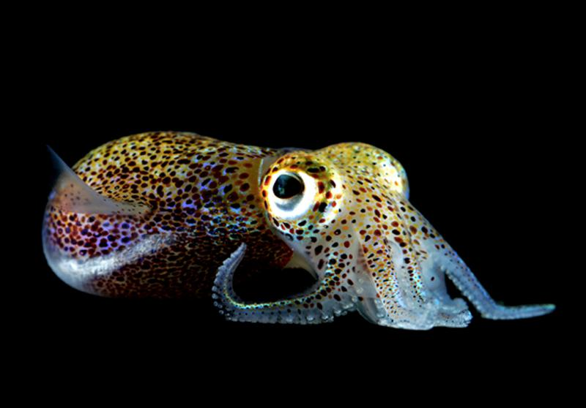
Chemical conversation
A curious light-producing bacterium called Vibrio fischeri uses quorum sensing molecules to sense when its population has grown to a certain size, at which point all the bacteria switch on their lights. The bacteria are symbiotic, living in an organ of the Hawaiian bobtail squid (Euprymna scolopes) that looks a bit like an eye. The bacteria’s luminescence prevents these squid from casting shadows on moonlit nights, in turn helping them avoid predators. Credit: MJ McFall-Ngai

Slide 3
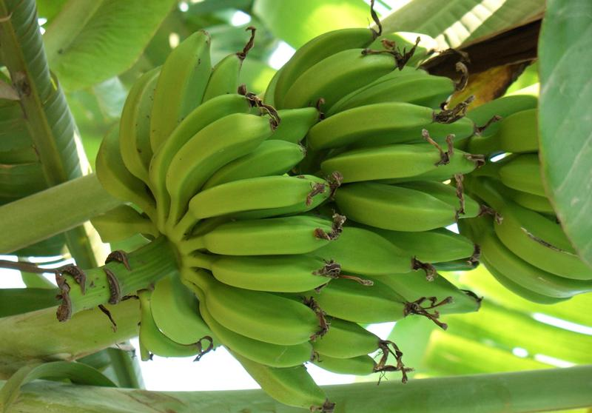
Population under threat
The bananas we eat are not grown from seeds, but are cloned using cuttings. This means every banana you’ve ever eaten is a clone, making the banana population particularly vulnerable to disease. The Cavendish, the type you are probably familiar with, replaced a variety called the Gros Michel after it succumbed to a soil fungus in the 1950s.
Credit: FreeImages/Dorothea Krapp
BIGPICTUREEDUCATION.COM

Slide 4
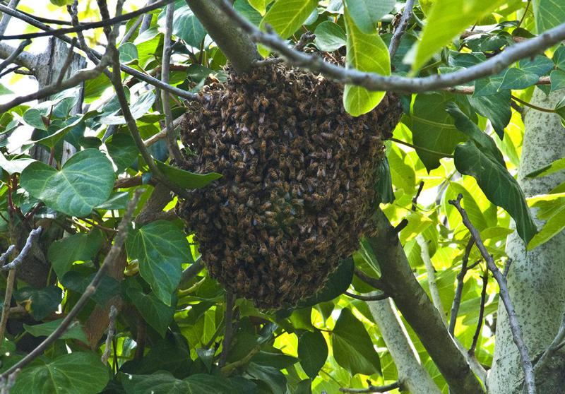
Population sustainers
Bees sustain many other populations of plants and animals via their role as pollinators. However, since 2006 the global bee population has been in decline for reasons that aren’t entirely clear. Some research suggests that a combination of a virus and a fungus could be behind the decline in North America.
Credit: FreeImages/Robert Elliott
BIGPICTUREEDUCATION.COM

Slide 5
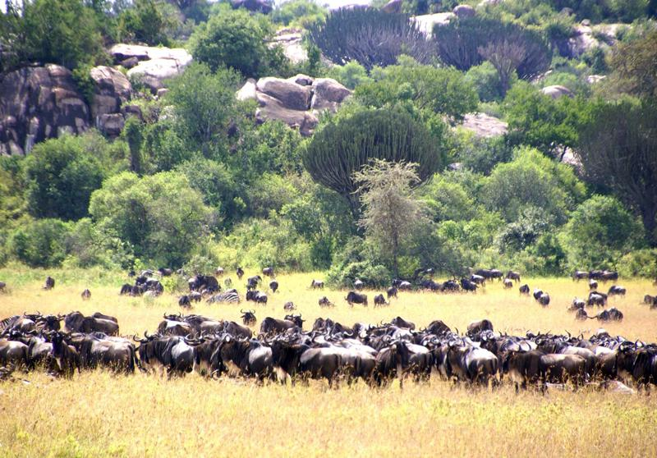
Wildebeest migration
The wildebeests of the Serengeti in eastern Africa live in huge herds that migrate in a fairly predictable circular pattern throughout the year. Calves are born in February, just in time for the rainy season, after which the herds make their way north in search of fresh grazing. They cross the Grumeti river into the northern Serengeti in the summer, before making their return trip in November.
Credit: FreeImages/Eva Schuster
BIGPICTUREEDUCATION.COM

Slide 6
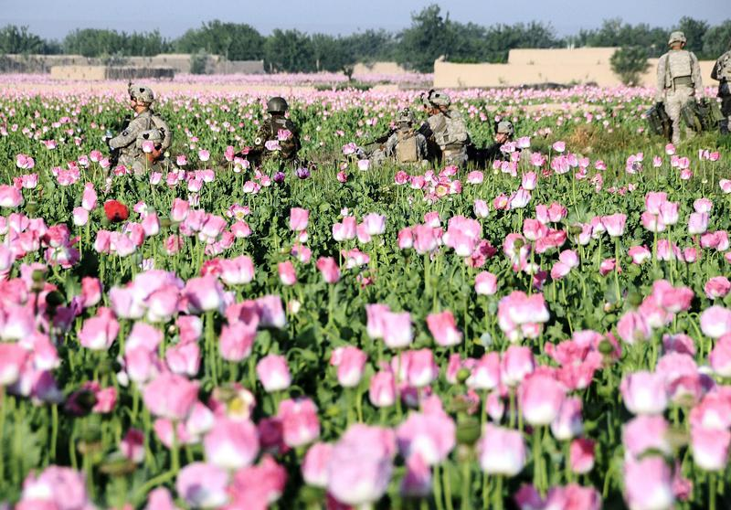
Opium poppies
The poppy population in Afghanistan rose by 36 per cent in 2013, making it a record-breaking year for the crop; poppies now cover more than 200 000 hectares of the war-torn country, an area larger than the island nation of Mauritius. A struggling economy and political instability are thought to be driving the rise of the poppy in Afghanistan, which is the world’s biggest producer of opium, a drug harvested from the plant. Credit: Flickr/isafmedia
BIGPICTUREEDUCATION.COM

Slide 7
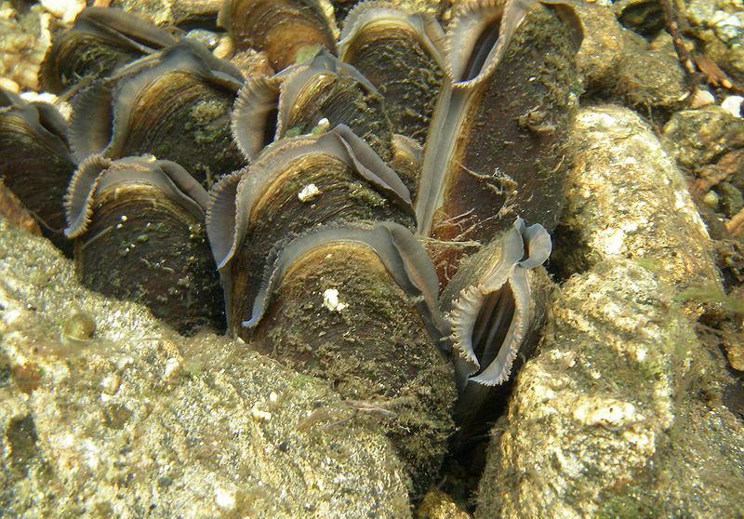
Freshwater mussels and dams
Mussels are crucial in keeping rivers clean by filtering out bacteria from the water. Their microscopic offspring, called glochidia, have tiny hooks that enable them to hitch a ride on passing fish. The construction of dams can negatively impact freshwater mussel populations, as they reduce the number of fish in rivers. Credit: Joel Berglund
BIGPICTUREEDUCATION.COM

Slide 8
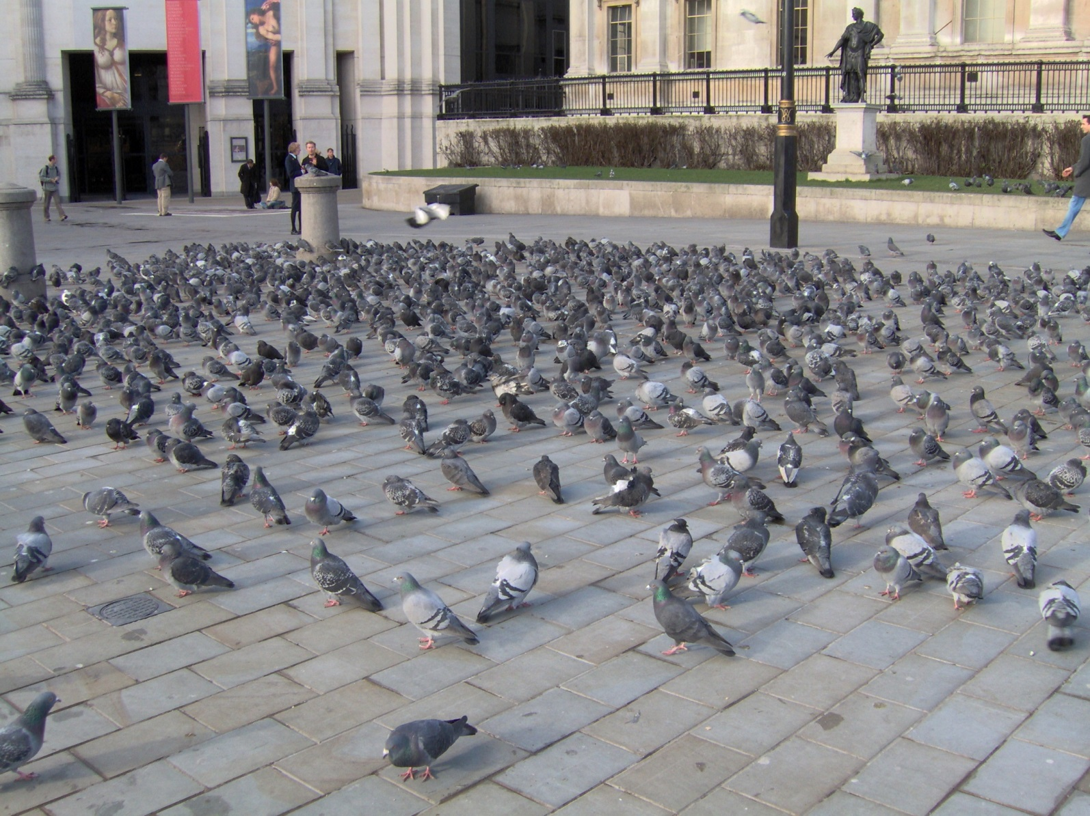
Feral pigeons
Feral pigeons and domesticated homing pigeons are descendants of the rock pigeon, a species that roosts on sea cliffs, and all three can interbreed. Pigeons have adapted to city life, substituting cliffs for ledges on buildings and living off scraps and waste food. In some cities the pigeon’s natural predator, the peregrine falcon, has been introduced to curb their burgeoning numbers.
Credit: ProhibitOnions, Wikimedia Commons
BIGPICTUREEDUCATION.COM

Slide 9
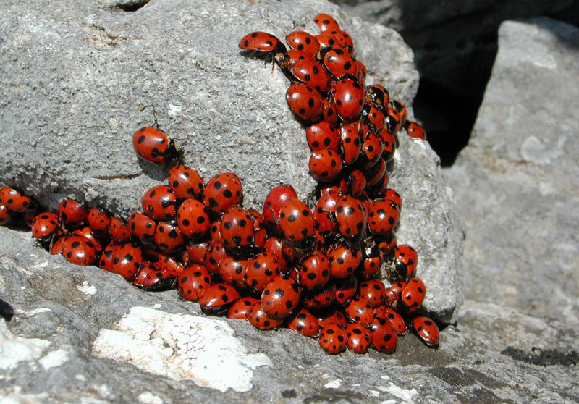
Non-native populations
Known for its beauty, the seven-spot ladybird is under threat from its invasive cousin, the harlequin, which eats seven-spot ladybird larvae and carries a deadly parasite. The parasite isn’t harmful to the harlequin, which was introduced into Europe from Asia to control aphids, but has led to a decline in the population sizes of native species. Credit: FreeImages/Ezio Puddu
BIGPICTUREEDUCATION.COM

Slide 10
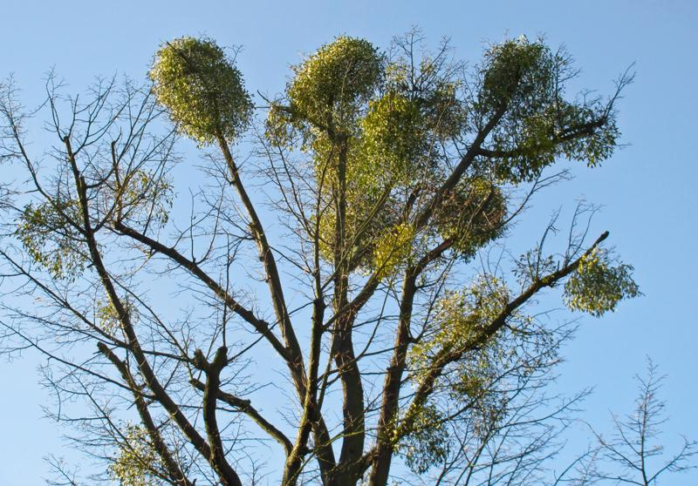
Partial parasite
Mistletoe is found in the South and West Midlands, but the plant has been spreading fast in the eastern parts of Britain due to the blackcap, a migrant bird from Germany that visits the country each winter, bringing with it the plant’s seeds. Mistletoe is sometimes called a partial parasite, because it attaches itself to host trees to gather nutrients but then uses these to photosynthesise independently. Its victims include the apple, hawthorn, lime and poplar trees, which can be debilitated by its grasp. Credit: FreeImages/Michael and Christa RIchert
BIGPICTUREEDUCATION.COM

Slide 11
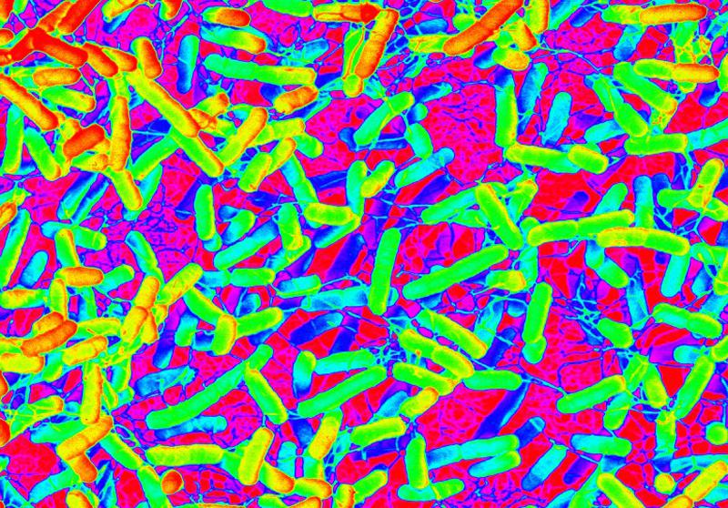
Bacterial populations
This is a scanning electron micrograph showing a magnification of E. coli, a bacterium that lives inside the intestines of humans and animals. Most of its strains are harmless, aiding in digestion and protecting humans and animals from other harmful microbes. However, some strains, for example E. coli O157:H7, disrupt the normal functions of the intestine by causing its cells either to absorb less water or to release water, resulting in diarrhoea. Credit: Wellcome Images/Debbie Marshall
BIGPICTUREEDUCATION.COM

