Slide 1
Heart Structure
iDiagram Activity
Adapted from Biology OL Exam Paper 2004

Slide 2
Make your selection
CLICK HERE
to identify
PARTS
CLICK HERE
to identify
FUNCTIONS

Slide 3
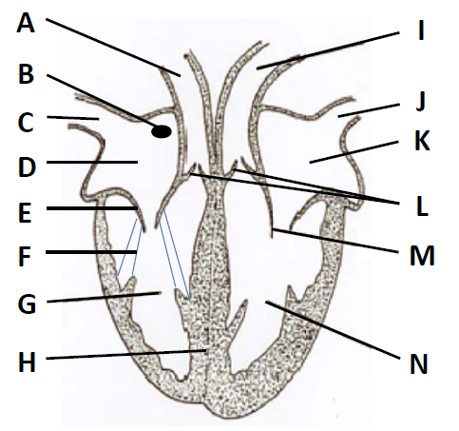
Name the part labelled A in the diagram
Aorta
Bicuspid valve
Chordae tendinae
Left atrium/auricle
Left ventricle
Pacemaker
Pulmonary artery
Pulmonary vein
Right atrium/auricle
Semi-lunar valves
Tricuspid valve
Right ventricle
Septum
Vena cava

Slide 4
CONGRATULATIONS
Please CLICK on
THIS BOX
for the Next Question

Slide 5
Name the part labelled B in the diagram
Aorta
Bicuspid valve
Chordae tendinae
Left atrium/auricle
Left ventricle
Pacemaker
Pulmonary artery
Pulmonary vein
Right atrium/auricle
Semi-lunar valves
Tricuspid valve
Right ventricle
Septum
Vena cava

Slide 6
CONGRATULATIONS
Please CLICK on
THIS BOX
for the Next Question

Slide 7
Name the part labelled C in the diagram
Aorta
Bicuspid valve
Chordae tendinae
Left atrium/auricle
Left ventricle
Pacemaker
Pulmonary artery
Pulmonary vein
Right atrium/auricle
Semi-lunar valves
Tricuspid valve
Right ventricle
Septum
Vena cava

Slide 8
CONGRATULATIONS
Please CLICK on
THIS BOX
for the Next Question

Slide 9
Name the part labelled D in the diagram
Aorta
Bicuspid valve
Chordae tendinae
Left atrium/auricle
Left ventricle
Pacemaker
Pulmonary artery
Pulmonary vein
Right atrium/auricle
Semi-lunar valves
Tricuspid valve
Right ventricle
Septum
Vena cava

Slide 10
CONGRATULATIONS
Please CLICK on
THIS BOX
for the Next Question

Slide 11
Name the part labelled E in the diagram
Aorta
Bicuspid valve
Chordae tendinae
Left atrium/auricle
Left ventricle
Pacemaker
Pulmonary artery
Pulmonary vein
Right atrium/auricle
Semi-lunar valves
Tricuspid valve
Right ventricle
Septum
Vena cava

Slide 12
CONGRATULATIONS
Please CLICK on
THIS BOX
for the Next Question

Slide 13
Name the part labelled F in the diagram
Aorta
Bicuspid valve
Chordae tendinae
Left atrium/auricle
Left ventricle
Pacemaker
Pulmonary artery
Pulmonary vein
Right atrium/auricle
Semi-lunar valves
Tricuspid valve
Right ventricle
Septum
Vena cava

Slide 14
CONGRATULATIONS
Please CLICK on
THIS BOX
for the Next Question

Slide 15
Name the part labelled G in the diagram
Aorta
Bicuspid valve
Chordae tendinae
Left atrium/auricle
Left ventricle
Pacemaker
Pulmonary artery
Pulmonary vein
Right atrium/auricle
Semi-lunar valves
Tricuspid valve
Right ventricle
Septum
Vena cava

Slide 16
CONGRATULATIONS
Please CLICK on
THIS BOX
for the Next Question

Slide 17
Name the part labelled H in the diagram
Aorta
Bicuspid valve
Chordae tendinae
Left atrium/auricle
Left ventricle
Pacemaker
Pulmonary artery
Pulmonary vein
Right atrium/auricle
Semi-lunar valves
Tricuspid valve
Right ventricle
Septum
Vena cava

Slide 18
CONGRATULATIONS
Please CLICK on
THIS BOX
for the Next Question

Slide 19
Name the part labelled I in the diagram
Aorta
Bicuspid valve
Chordae tendinae
Left atrium/auricle
Left ventricle
Pacemaker
Pulmonary artery
Pulmonary vein
Right atrium/auricle
Semi-lunar valves
Tricuspid valve
Right ventricle
Septum
Vena cava

Slide 20
CONGRATULATIONS
Please CLICK on
THIS BOX
for the Next Question

Slide 21
Name the part labelled J in the diagram
Aorta
Bicuspid valve
Chordae tendinae
Left atrium/auricle
Left ventricle
Pacemaker
Pulmonary artery
Pulmonary vein
Right atrium/auricle
Semi-lunar valves
Tricuspid valve
Right ventricle
Septum
Vena cava

Slide 22
CONGRATULATIONS
Please CLICK on
THIS BOX
for the Next Question

Slide 23
Name the part labelled K in the diagram
Aorta
Bicuspid valve
Chordae tendinae
Left atrium/auricle
Left ventricle
Pacemaker
Pulmonary artery
Pulmonary vein
Right atrium/auricle
Semi-lunar valves
Tricuspid valve
Right ventricle
Septum
Vena cava

Slide 24
CONGRATULATIONS
Please CLICK on
THIS BOX
for the Next Question

Slide 25
Name the part labelled L in the diagram
Aorta
Bicuspid valve
Chordae tendinae
Left atrium/auricle
Left ventricle
Pacemaker
Pulmonary artery
Pulmonary vein
Right atrium/auricle
Semi-lunar valves
Tricuspid valve
Right ventricle
Septum
Vena cava

Slide 26
CONGRATULATIONS
Please CLICK on
THIS BOX
for the Next Question

Slide 27
Name the part labelled M in the diagram
Aorta
Bicuspid valve
Chordae tendinae
Left atrium/auricle
Left ventricle
Pacemaker
Pulmonary artery
Pulmonary vein
Right atrium/auricle
Semi-lunar valves
Tricuspid valve
Right ventricle
Septum
Vena cava

Slide 28
CONGRATULATIONS
Please CLICK on
THIS BOX
for the Next Question

Slide 29
Name the part labelled N in the diagram
Aorta
Bicuspid valve
Chordae tendinae
Left atrium/auricle
Left ventricle
Pacemaker
Pulmonary artery
Pulmonary vein
Right atrium/auricle
Semi-lunar valves
Tricuspid valve
Right ventricle
Septum
Vena cava

Slide 30
CONGRATULATIONS
Please CLICK on
THIS BOX
for the Next Question

Slide 31
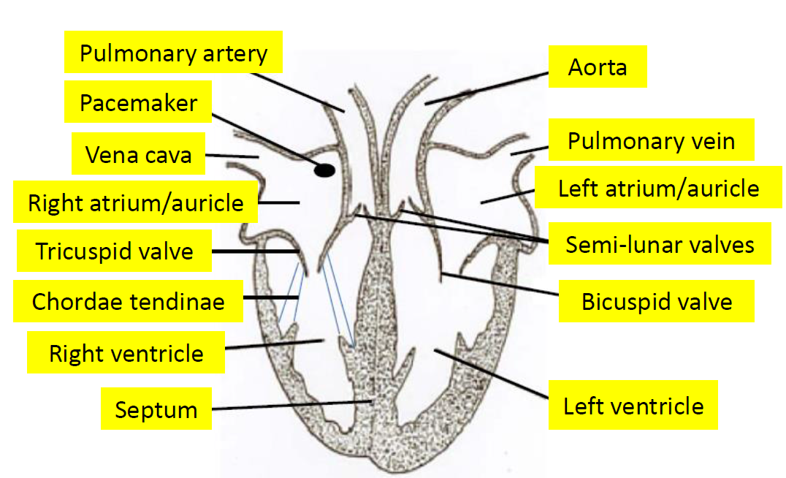
Heart Structure – Labelled diagram
CLICK HERE

Slide 32
CONGRATULATIONS You’re Brilliant
Click on this box to REPEAT this activity or press ESC to quit

Slide 33
What is the function of the pulmonary artery?
A wall that divides a structure into two parts
Prevent the backflow of blood, between the right atrium and right ventricle
Receive blood from the pulmonary veins
Prevent the valves blowing inside out when the ventricles contract
Bring blood from the heart to the lungs
Receive blood from the right auricle and pass it into the pulmonary artery
Bring blood to the heart from the lungs
Receive blood from the left auricle and pass it into the aorta
Carry oxygenated blood to the tissues of the body
Bring blood from the body back to the right atrium of the heart
Receive blood from the venae cavae
Prevent blood flowing from the left ventricle to the left atrium
Prevent the backflow of blood into the heart
Send out waves of impulses to muscles of both atria causing atria to contract

Slide 34
CONGRATULATIONS
Please CLICK on
THIS BOX
for the Next Question

Slide 35
What is the function of the pacemaker?
A wall that divides a structure into two parts
Prevent the backflow of blood, between the right atrium and right ventricle
Receive blood from the pulmonary veins
Prevent the valves blowing inside out when the ventricles contract
Bring blood from the heart to the lungs
Receive blood from the right auricle and pass it into the pulmonary artery
Bring blood to the heart from the lungs
Receive blood from the left auricle and pass it into the aorta
Carry oxygenated blood to the tissues of the body
Bring blood from the body back to the right atrium of the heart
Receive blood from the venae cavae
Prevent blood flowing from the left ventricle to the left atrium
Prevent the backflow of blood into the heart
Send out waves of impulses to muscles of both atria causing atria to contract

Slide 36
CONGRATULATIONS
Please CLICK on
THIS BOX
for the Next Question

Slide 37
What is the function of the vena cava?
A wall that divides a structure into two parts
Prevent the backflow of blood, between the right atrium and right ventricle
Receive blood from the pulmonary veins
Prevent the valves blowing inside out when the ventricles contract
Bring blood from the heart to the lungs
Receive blood from the right auricle and pass it into the pulmonary artery
Bring blood to the heart from the lungs
Receive blood from the left auricle and pass it into the aorta
Carry oxygenated blood to the tissues of the body
Bring blood from the body back to the right atrium of the heart
Receive blood from the venae cavae
Prevent blood flowing from the left ventricle to the left atrium
Prevent the backflow of blood into the heart
Send out waves of impulses to muscles of both atria causing atria to contract

Slide 38
CONGRATULATIONS
Please CLICK on
THIS BOX
for the Next Question

Slide 39
What is the function of the right atrium/auricle?
A wall that divides a structure into two parts
Prevent the backflow of blood, between the right atrium and right ventricle
Receive blood from the pulmonary veins
Prevent the valves blowing inside out when the ventricles contract
Bring blood from the heart to the lungs
Receive blood from the right auricle and pass it into the pulmonary artery
Bring blood to the heart from the lungs
Receive blood from the left auricle and pass it into the aorta
Carry oxygenated blood to the tissues of the body
Bring blood from the body back to the right atrium of the heart
Receive blood from the venae cavae
Prevent blood flowing from the left ventricle to the left atrium
Prevent the backflow of blood into the heart
Send out waves of impulses to muscles of both atria causing atria to contract

Slide 40
CONGRATULATIONS
Please CLICK on
THIS BOX
for the Next Question

Slide 41
What is the function of the tricuspid valve?
A wall that divides a structure into two parts
Prevent the backflow of blood, between the right atrium and right ventricle
Receive blood from the pulmonary veins
Prevent the valves blowing inside out when the ventricles contract
Bring blood from the heart to the lungs
Receive blood from the right auricle and pass it into the pulmonary artery
Bring blood to the heart from the lungs
Receive blood from the left auricle and pass it into the aorta
Carry oxygenated blood to the tissues of the body
Bring blood from the body back to the right atrium of the heart
Receive blood from the venae cavae
Prevent blood flowing from the left ventricle to the left atrium
Prevent the backflow of blood into the heart
Send out waves of impulses to muscles of both atria causing atria to contract

Slide 42
CONGRATULATIONS
Please CLICK on
THIS BOX
for the Next Question

Slide 43
What is the function of the chordae tendinae?
A wall that divides a structure into two parts
Prevent the backflow of blood, between the right atrium and right ventricle
Receive blood from the pulmonary veins
Prevent the valves blowing inside out when the ventricles contract
Bring blood from the heart to the lungs
Receive blood from the right auricle and pass it into the pulmonary artery
Bring blood to the heart from the lungs
Receive blood from the left auricle and pass it into the aorta
Carry oxygenated blood to the tissues of the body
Bring blood from the body back to the right atrium of the heart
Receive blood from the venae cavae
Prevent blood flowing from the left ventricle to the left atrium
Prevent the backflow of blood into the heart
Send out waves of impulses to muscles of both atria causing atria to contract

Slide 44
CONGRATULATIONS
Please CLICK on
THIS BOX
for the Next Question

Slide 45
What is the function of the right ventricle?
A wall that divides a structure into two parts
Prevent the backflow of blood, between the right atrium and right ventricle
Receive blood from the pulmonary veins
Prevent the valves blowing inside out when the ventricles contract
Bring blood from the heart to the lungs
Receive blood from the right auricle and pass it into the pulmonary artery
Bring blood to the heart from the lungs
Receive blood from the left auricle and pass it into the aorta
Carry oxygenated blood to the tissues of the body
Bring blood from the body back to the right atrium of the heart
Receive blood from the venae cavae
Prevent blood flowing from the left ventricle to the left atrium
Prevent the backflow of blood into the heart
Send out waves of impulses to muscles of both atria causing atria to contract

Slide 46
CONGRATULATIONS
Please CLICK on
THIS BOX
for the Next Question

Slide 47
What is a septum?
A wall that divides a structure into two parts
Prevent the backflow of blood, between the right atrium and right ventricle
Receive blood from the pulmonary veins
Prevent the valves blowing inside out when the ventricles contract
Bring blood from the heart to the lungs
Receive blood from the right auricle and pass it into the pulmonary artery
Bring blood to the heart from the lungs
Receive blood from the left auricle and pass it into the aorta
Carry oxygenated blood to the tissues of the body
Bring blood from the body back to the right atrium of the heart
Receive blood from the venae cavae
Prevent blood flowing from the left ventricle to the left atrium
Prevent the backflow of blood into the heart
Send out waves of impulses to muscles of both atria causing atria to contract

Slide 48
CONGRATULATIONS
Please CLICK on
THIS BOX
for the Next Question

Slide 49
What is the function of the aorta?
A wall that divides a structure into two parts
Prevent the backflow of blood, between the right atrium and right ventricle
Receive blood from the pulmonary veins
Prevent the valves blowing inside out when the ventricles contract
Bring blood from the heart to the lungs
Receive blood from the right auricle and pass it into the pulmonary artery
Bring blood to the heart from the lungs
Receive blood from the left auricle and pass it into the aorta
Carry oxygenated blood to the tissues of the body
Bring blood from the body back to the right atrium of the heart
Receive blood from the venae cavae
Prevent blood flowing from the left ventricle to the left atrium
Prevent the backflow of blood into the heart
Send out waves of impulses to muscles of both atria causing atria to contract

Slide 50
CONGRATULATIONS
Please CLICK on
THIS BOX
for the Next Question

Slide 51
What is the function of the pulmonary vein?
A wall that divides a structure into two parts
Prevent the backflow of blood, between the right atrium and right ventricle
Receive blood from the pulmonary veins
Prevent the valves blowing inside out when the ventricles contract
Bring blood from the heart to the lungs
Receive blood from the right auricle and pass it into the pulmonary artery
Bring blood to the heart from the lungs
Receive blood from the left auricle and pass it into the aorta
Carry oxygenated blood to the tissues of the body
Bring blood from the body back to the right atrium of the heart
Receive blood from the venae cavae
Prevent blood flowing from the left ventricle to the left atrium
Prevent the backflow of blood into the heart
Send out waves of impulses to muscles of both atria causing atria to contract

Slide 52
CONGRATULATIONS
Please CLICK on
THIS BOX
for the Next Question

Slide 53
What is the function of the left atrium/auricle?
A wall that divides a structure into two parts
Prevent the backflow of blood, between the right atrium and right ventricle
Receive blood from the pulmonary veins
Prevent the valves blowing inside out when the ventricles contract
Bring blood from the heart to the lungs
Receive blood from the right auricle and pass it into the pulmonary artery
Bring blood to the heart from the lungs
Receive blood from the left auricle and pass it into the aorta
Carry oxygenated blood to the tissues of the body
Bring blood from the body back to the right atrium of the heart
Receive blood from the venae cavae
Prevent blood flowing from the left ventricle to the left atrium
Prevent the backflow of blood into the heart
Send out waves of impulses to muscles of both atria causing atria to contract

Slide 54
CONGRATULATIONS
Please CLICK on
THIS BOX
for the Next Question

Slide 55
What is the function of the semi-lunar valves?
A wall that divides a structure into two parts
Prevent the backflow of blood, between the right atrium and right ventricle
Receive blood from the pulmonary veins
Prevent the valves blowing inside out when the ventricles contract
Bring blood from the heart to the lungs
Receive blood from the right auricle and pass it into the pulmonary artery
Bring blood to the heart from the lungs
Receive blood from the left auricle and pass it into the aorta
Carry oxygenated blood to the tissues of the body
Bring blood from the body back to the right atrium of the heart
Receive blood from the venae cavae
Prevent blood flowing from the left ventricle to the left atrium
Prevent the backflow of blood into the heart
Send out waves of impulses to muscles of both atria causing atria to contract

Slide 56
CONGRATULATIONS
Please CLICK on
THIS BOX
for the Next Question

Slide 57
What is the function of the bicuspid valve?
A wall that divides a structure into two parts
Prevent the backflow of blood, between the right atrium and right ventricle
Receive blood from the pulmonary veins
Prevent the valves blowing inside out when the ventricles contract
Bring blood from the heart to the lungs
Receive blood from the right auricle and pass it into the pulmonary artery
Bring blood to the heart from the lungs
Receive blood from the left auricle and pass it into the aorta
Carry oxygenated blood to the tissues of the body
Bring blood from the body back to the right atrium of the heart
Receive blood from the venae cavae
Prevent blood flowing from the left ventricle to the left atrium
Prevent the backflow of blood into the heart
Send out waves of impulses to muscles of both atria causing atria to contract

Slide 58
CONGRATULATIONS
Please CLICK on
THIS BOX
for the Next Question

Slide 59
What is the function of the left ventricle?
A wall that divides a structure into two parts
Prevent the backflow of blood, between the right atrium and right ventricle
Receive blood from the pulmonary veins
Prevent the valves blowing inside out when the ventricles contract
Bring blood from the heart to the lungs
Receive blood from the right auricle and pass it into the pulmonary artery
Bring blood to the heart from the lungs
Receive blood from the left auricle and pass it into the aorta
Carry oxygenated blood to the tissues of the body
Bring blood from the body back to the right atrium of the heart
Receive blood from the venae cavae
Prevent blood flowing from the left ventricle to the left atrium
Prevent the backflow of blood into the heart
Send out waves of impulses to muscles of both atria causing atria to contract

Slide 60
CONGRATULATIONS
Please CLICK on
THIS BOX
for the Next Question

Slide 61
Heart Structure – Labelled diagram
CLICK HERE

Slide 62
Incorrect
Please CLICK on
THIS BOX
to Try Again

