Slide 1
Nitrogen Cycle
iDiagram Activity
Diagram created by SLSS Teacher Design Team

Slide 2
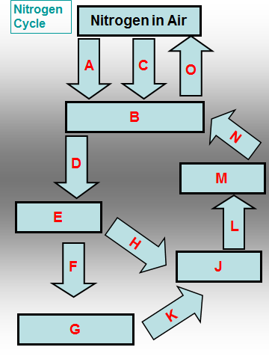
Name the process A that converts nitrogen gas into a form usable by plants
Eaten
Lightening
N₂ Fixing
Nitrates in soil
Nitrification
Nitrites
Plant proteins

Slide 3
CONGRATULATIONS
Please CLICK on
THIS BOX
for the Next Question

Slide 4
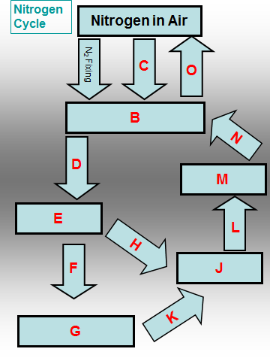
Nitrogen fixing converts nitrogen gas into B
Eaten
Lightening
N₂ Fixing
Nitrates in soil
Nitrification
Nitrites
Plant proteins

Slide 5
CONGRATULATIONS
Please CLICK on
THIS BOX
for the Next Question

Slide 6
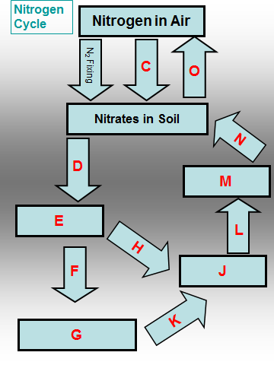
C Natures way of converting atmospheric nitrogen to nitrates
Eaten
Lightening
N₂ Fixing
Nitrates in soil
Nitrification
Nitrites
Plant proteins

Slide 7
CONGRATULATIONS
Please CLICK on
THIS BOX
for the Next Question

Slide 8
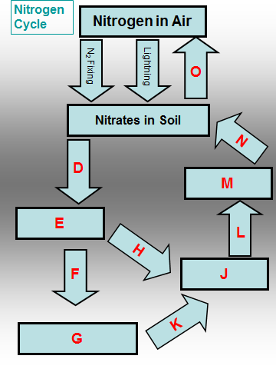
Soil nitrates are absorbed by plant roots and undergo D
Ammonium compounds
Animal proteins
Assimilation
Decomposition
Denitrification
Eaten
Lightening

Slide 9
CONGRATULATIONS
Please CLICK on
THIS BOX
for the Next Question

Slide 10
Plants assimilate nitrates into E
Eaten
Lightening
N₂ Fixing
Nitrates in soil
Nitrification
Nitrites
Plant proteins

Slide 11
CONGRATULATIONS
Please CLICK on
THIS BOX
for the Next Question

Slide 12
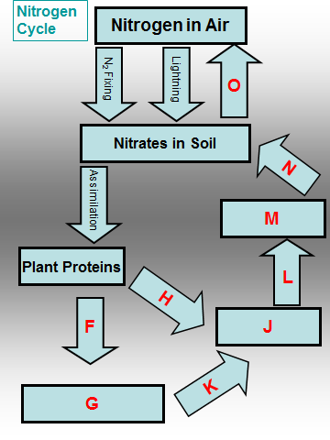
F Plants can then be … by animals
Eaten
Lightening
N₂ Fixing
Nitrates in soil
Nitrification
Nitrites
Plant proteins

Slide 13
CONGRATULATIONS
Please CLICK on
THIS BOX
for the Next Question

Slide 14
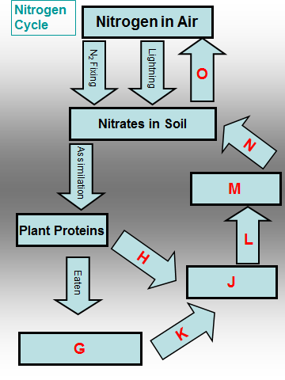
Animals convert the plant protein into G
Ammonium compounds
Animal proteins
Assimilation
Decomposition
Denitrification
Eaten
Lightening

Slide 15
CONGRATULATIONS
Please CLICK on
THIS BOX
for the Next Question

Slide 16
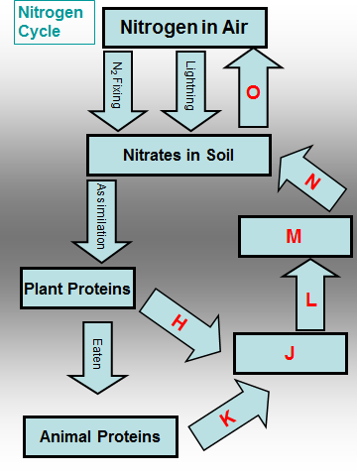
Plants eventually die and undergo H
Ammonium compounds
Animal proteins
Assimilation
Decomposition
Denitrification
Eaten
Lightening

Slide 17
CONGRATULATIONS
Please CLICK on
THIS BOX
for the Next Question

Slide 18
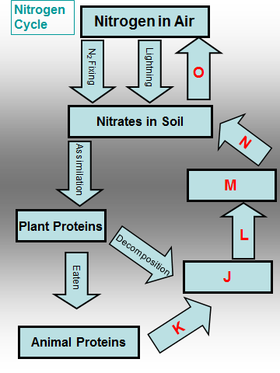
J These are formed as a result of the death of plants
Ammonium compounds
Animal proteins
Assimilation
Decomposition
Denitrification
Eaten
Lightening

Slide 19
CONGRATULATIONS
Please CLICK on
THIS BOX
for the Next Question

Slide 20
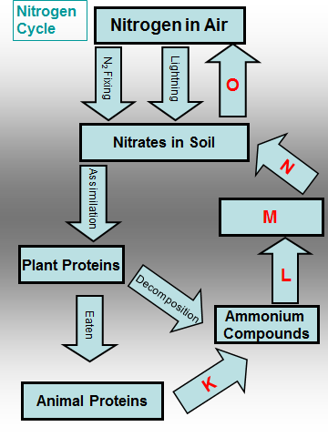
K What causes the conversion of animal protein to ammonium compounds?
Ammonium compounds
Animal proteins
Assimilation
Decomposition
Denitrification
Eaten
Lightening

Slide 21
CONGRATULATIONS
Please CLICK on
THIS BOX
for the Next Question

Slide 22
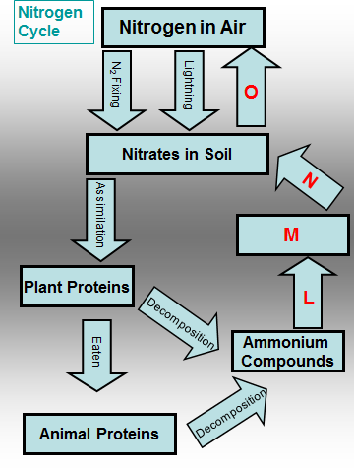
L Ammonia undergoes what process?
Eaten
Lightening
N₂ Fixing
Nitrates in soil
Nitrification
Nitrites
Plant proteins

Slide 23
CONGRATULATIONS
Please CLICK on
THIS BOX
for the Next Question

Slide 24
Ammonia undergoes nitrification to form M
Eaten
Lightening
N₂ Fixing
Nitrates in soil
Nitrification
Nitrites
Plant proteins

Slide 25
CONGRATULATIONS
Please CLICK on
THIS BOX
for the Next Question

Slide 26
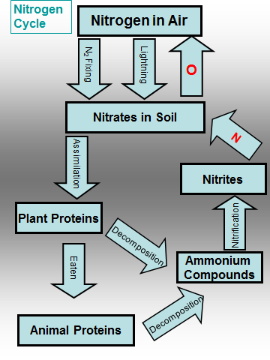
N Nitrites are converted to nitrates by what process?
Eaten
Lightening
N₂ Fixing
Nitrates in soil
Nitrification
Nitrites
Plant proteins

Slide 27
CONGRATULATIONS
Please CLICK on
THIS BOX
for the Next Question

Slide 28
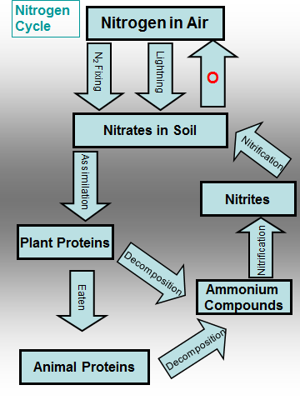
O Bacteria in the soil convert nitrates back into nitrogen gas in a process known as …
Ammonium compounds
Animal proteins
Assimilation
Decomposition
Denitrification
Eaten
Lightening

Slide 29
CONGRATULATIONS
Please CLICK on
THIS BOX
for the Next Question

Slide 30
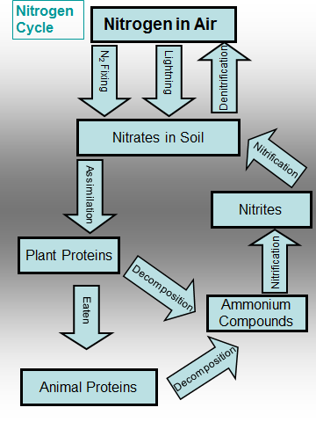
CLICK HERE

Slide 31
CONGRATULATIONS You’re Brilliant
Click on this box to REPEAT this activity or press ESC to quit

Slide 32
Incorrect
Please CLICK on
THIS BOX
to Try Again

